Slide 1
Integrate with Power Platform and Common Data Service
Notes:
Reference https://docs.microsoft.com/en-us/learn/paths/integrate-power-platform/

Slide 2
What is Microsoft Dataverse?
Note
Effective November 2020:
Common Data Service has been renamed to Microsoft Dataverse. Learn more
Some terminology in Microsoft Dataverse has been updated. For example, entity is now table and field is now column. Learn more

Slide 3
Agenda
Work with Common Data Service Web API
Integrate Common Data Service Azure solutions

Slide 4

Work with Common Data Service Web API

Slide 5
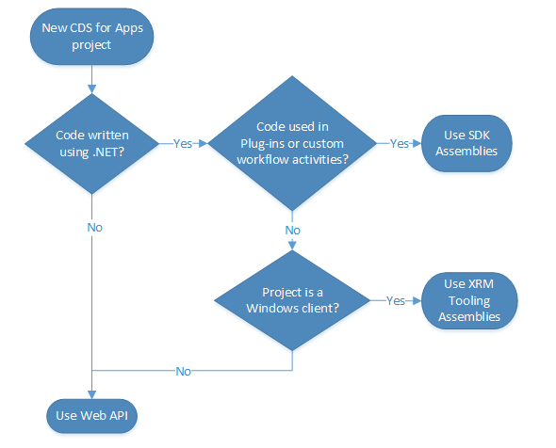
Web API vs. the Organization Service
Two main ways for interacting with data and metadata in Common Data Service are the Web API and the Organization Service.
OData 4.0
REST
FetchXML
Notes:
Two main ways for interacting with data and metadata in Common Data Service are the Web API and the Organization Service. You can use the Organization Service when writing plug-ins or workflow extensions by using the .NET Framework SDK assemblies that are provided by Microsoft.
At the time of this writing, all data operations go through the underlying Organization Service. As such, the Web API allows you to perform the same operations as the Organization Service but in a RESTful style (more information on REST will be provided later in this module).
The following graphic is a decision tree that can help you determine when to use the Web API versus the Organization Service (through SDK Assemblies) and also when to use XRM Tooling Assemblies (available from Microsoft) for Windows applications.
OData 4.0
Common Data Service Web API is implemented as an OData (OASIS Open Data Protocol) service. By using an industry standard such as this, you're allotted all the benefits of open standard development, such as cross-platform compatibility and simple implementation against a common, predefined protocol.
Common Data Service doesn't provide specific assembly tooling for the Web API; instead, we recommend that you use community libraries that conform to the OData protocol. If you want more information about which libraries exist, go to https://www.odata.org/libraries/.
OData provides the ability to interact with Common Data Service data by means of CRUD operations that are available through standard GET, POST, PATCH, and DELETE HTTP methods (more information about these methods will be provided later in this module). You can also perform almost any other operation that is exposed through Common Data Service Event Framework by invoking an OData function or action that has the same name as its corresponding Organization Service message. CRUD-related messages are the only ones that are not available because those messages are achieved by means of the previously-described standard HTTP methods.
REST
Fundamentally, OData protocol is a set of RESTful (REpresentational State Transfer) APIs, a time-tested industry standard for providing interoperability between systems. REST consists of six guiding principles that restrict the way that a service can process and respond to requests to ensure that non-functional properties of that service are met (such as performance, scalability, simplicity, reliability, and so on).
For the purposes of this lesson, you should keep in mind that OData conforms to these constraints and that the Common Data Web API in turn also conforms to the constraints because it implements the OData 4.0 protocol.
FetchXML
FetchXML is a robust query language that allows for complex querying of Common Data Service data. Microsoft provides a way for users to run FetchXML queries within a Web API query. This approach can be valuable if you encounter a scenario where FetchXML is a better fit for your particular query versus using OData query syntax. More information about FetchXML is provided in a later unit in this module.

Slide 6
Authenticate against Common Data Service by using OAuth
Microsoft's Common Data Service uses OAuth 2.0 as its authorization standard.
Notes:
Microsoft's Common Data Service uses OAuth 2.0 as its authorization standard. OAuth provides an industry-standardized mechanism for authenticating client applications against a resource.

Slide 7
Authentication vs. authorization
Authentication is the process or action of verifying the identity of a user or process. Microsoft's solution to this verification process is Azure Active Directory (Azure AD). Azure AD supports a number of options to verify the identity of a user or process. Abstracting your identity provider allows for a good separation of concerns because managing usernames and passwords can be a difficult (and risky) process.
Authorization is the process or action of verifying whether an authenticated user is authorized to access the resources that are being provided. Presently, authorization to Common Data Service is at the tenant level, and permissions are delegated to the application based on the current signed-in user. Therefore, you won't use OAuth to govern app-level security, which is instead handled by means of the Power Apps admin center.
Notes:
Authentication is the process or action of verifying the identity of a user or process. Microsoft's solution to this verification process is Azure Active Directory (Azure AD). Azure AD supports a number of options to verify the identity of a user or process. Abstracting your identity provider allows for a good separation of concerns because managing usernames and passwords can be a difficult (and risky) process.
Authorization is the process or action of verifying whether an authenticated user is authorized to access the resources that are being provided. Presently, authorization to Common Data Service is at the tenant level, and permissions are delegated to the application based on the current signed-in user. Therefore, you won't use OAuth to govern app-level security, which is instead handled by means of the Power Apps admin center.
If you want to learn more about the concepts of authentication and authorization, go to the Azure Active Directory section of Microsoft Docs: Authentication basics.

Slide 8
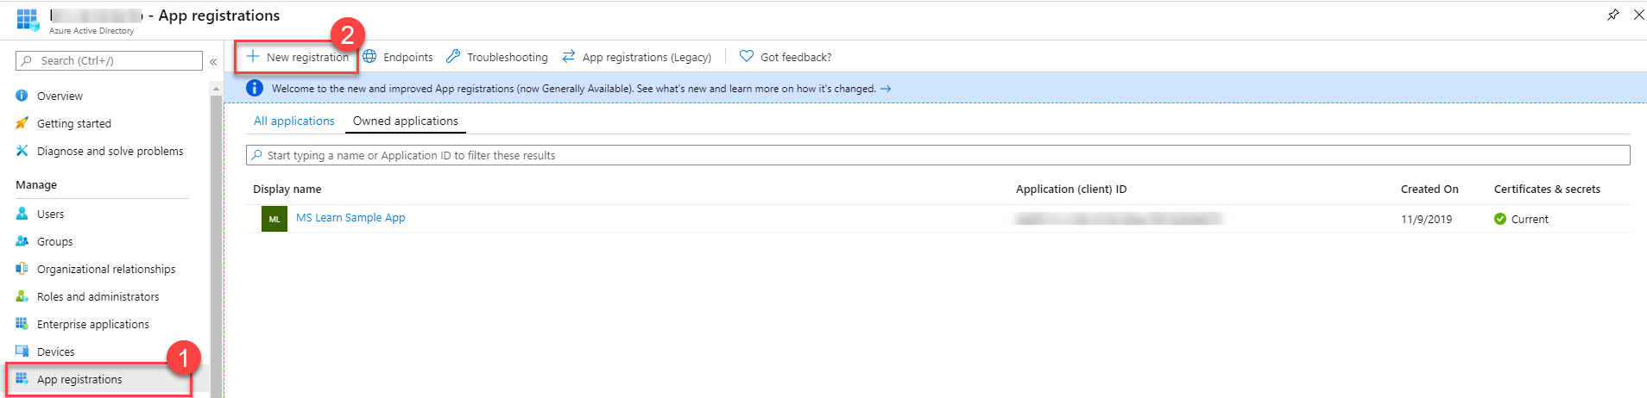
Register Common Data Service apps with Azure AD
To successfully connect to your Common Data Service, you must first register an app with Azure Active Directory, which can be completed in the Azure portal.
Notes:
To successfully connect to your Common Data Service, you must first register an app with Azure Active Directory, which can be completed in the Azure portal. Depending on the type of app that you want to make, a few different settings are available for you to configure (web apps versus native apps that are installed natively on a device). For more information on settings that are required for each of these types, see Types of app registration.
To register an app with Azure AD, you can go to the App Registrations section of the Azure Active Directory menu blade and then select New Registration.

Slide 9
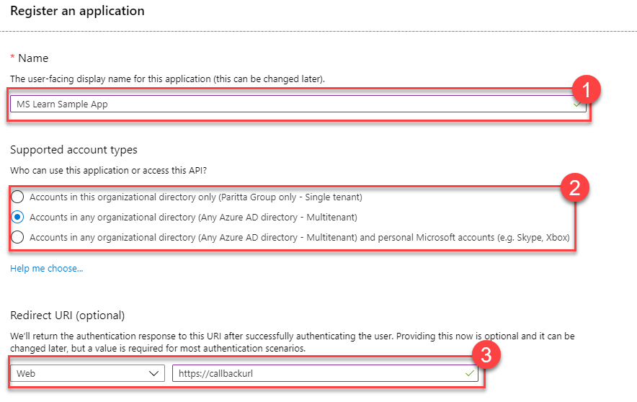
Register Common Data Service apps with Azure AD
Specify the name of your app and what type of account access you need. If you’re registering a web app, specify a Redirect URI by going to the Authentication section, setting the type to Web, and then entering a redirect URI.
Notes:
Specify the name of your app and what type of account access you need. If you're registering a web app, specify a Redirect URI by going to the Authentication section, setting the type to Web, and then entering a redirect URI.
The following list summarizes when to use the different account types:
Accounts in this organizational directory only (Single tenant)
All user and guest accounts in your directory can use your application or API.
Use this option if your target audience is internal to your organization.
Accounts in any organizational directory (Any Azure AD directory - Multitenant)
All users with a work or school account from Microsoft can use your application or API, including schools and businesses that use Microsoft 365.
Use this option if your target audience is business or educational customers and to enable multitenancy.
Accounts in any organizational directory (Any Azure AD directory - Multitenant) and personal Microsoft accounts (for example, Skype and Xbox)
All users with a work, school, or personal Microsoft account can use your application or API. It includes schools and businesses that use Microsoft 365 and personal accounts that are used to sign in to services like Xbox and Skype.
For this example, https://callbackurl was entered for the Redirect URI because you will be accessing with Postman in a later lesson, which is a public application. Note this URL because you will need it to connect to Common Data Service successfully.
Depending on the complexity of your application setup, you might want to configure other authentication settings. Refer to the Azure Active Directory documentation for steps on how to complete this task.

Slide 10
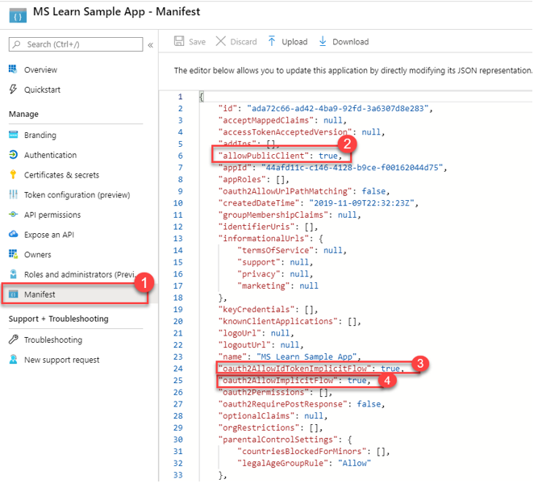
Azure Active Directory App manifest
Notes:
You will also need to set a few flags to true in the app’s manifest to allow access from Postman and other external applications. This access is only being granted for demonstration purposes only. We recommend that you read the Azure Active Directory app manifest documentation to fully understand the implications of these flags.

Slide 11
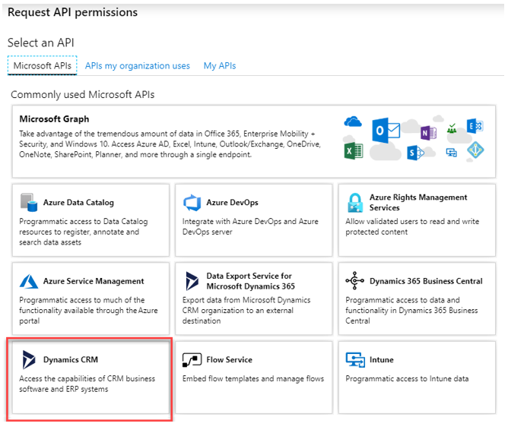
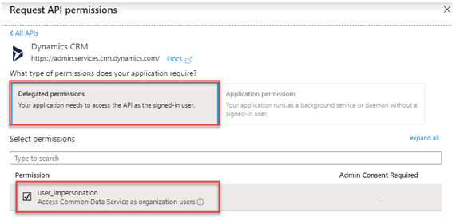
API permissions
Notes:
Next, go to the API permissions tab and ensure that your application is granted user impersonation access to your Dataverse environment.
You should now have an app endpoint that can successfully connect to your Dataverse environment.

Slide 12
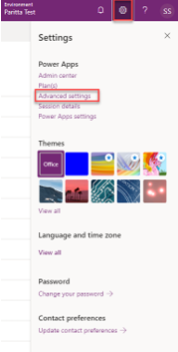
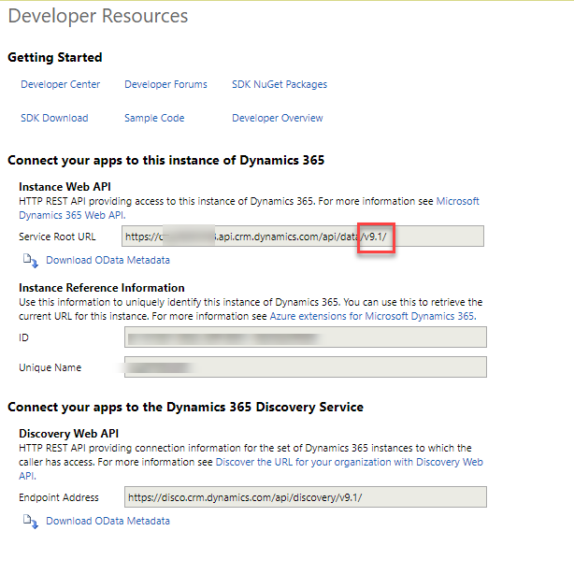
Interact with Common Data Service Web API by using Postman
Notes:
Postman is a valuable tool to use for composing ad hoc Web API queries and verifying the behavior of Web API Operations without having to write a program to do so. If you're new to Postman, see the First 5 things to try if you're new to Postman article for an introduction to the topic.
To connect Postman to Common Data Service, you must first ensure that you have an application registered in your Azure AD environment.
You can find the version number of your Web API endpoint by going to your environment's Advanced settings in the maker portal.
From Advanced settings, go to Settings > Customizations and then go to the Developer Resources page. Your version number will be indicated under the Instance Web API region, as shown in the following image.

Slide 13
Exercise: Set up Postman
Follow the scenario exercise in the student manual
Notes:
Exercise or potential demo
https://docs.microsoft.com/en-us/learn/modules/common-data-service-web-api/3-postman

Slide 14
Use OData to query data
Create records
OData
POST [Organization URI]/api/data/v9.0/accounts HTTP/1.1 Content-Type: application/json; charset=utf-8 OData-MaxVersion: 4.0 OData-Version: 4.0 Accept: application/json { "name": "Sample Account", "creditonhold": false, "address1_latitude": 47.639583, "description": "This is the description of the sample account", "revenue": 5000000, "accountcategorycode": 1 }
Notes:
OData is a time-tested language for querying RESTful APIs. This lesson explores a few ways of performing CRUD operations against Common Data Service data.
To create records, use the HTTP POST method.

Slide 15
Use OData to query data
Retrieve records
OData
GET [Organization URI]/api/data/v9.0/accounts(00000000-0000-0000-0000-000000000001)
Notes:
To retrieve records, use the HTTP GET method.
The following sample retrieves an account with the ID of 00000000-0000-0000-0000-000000000001:
GET [Organization URI]/api/data/v9.0/accounts(00000000-0000-0000-0000-000000000001)
Other methods are available for querying data by using standard OData query syntax. For more information on this process, see Retrieve an entity record using the Web API.

Slide 16
Use OData to query data
Update records
OData
PATCH [Organization URI]/api/data/v9.0/accounts(00000000-0000-0000-0000-000000000001) HTTP/1.1
Content-Type: application/json
OData-MaxVersion: 4.0
OData-Version: 4.0
{
"name": "Updated Sample Account ",
"creditonhold": true,
"address1_latitude": 47.639583,
"description": "This is the updated description of the sample account",
"revenue": 6000000,
"accountcategorycode": 2
}
Notes:
Depending on what you are trying to accomplish, you can choose between one of two methods for updating records:
If you are performing an update of multiple attribute values, use the HTTP PATCH method. PATCH methods provide upsert capability if you provide an ID value as part of your request, a beneficial feature when you are synchronizing data between systems.
If you are updating a single attribute value, use the HTTP PUT method. This method can't be used with navigation properties like lookups because that requires a reference to be removed as well.
The following example updates an account entity:
PATCH [Organization URI]/api/data/v9.0/accounts(00000000-0000-0000-0000-000000000001) HTTP/1.1 Content-Type: application/json OData-MaxVersion: 4.0 OData-Version: 4.0 { "name": "Updated Sample Account ", "creditonhold": true, "address1_latitude": 47.639583, "description": "This is the updated description of the sample account", "revenue": 6000000, "accountcategorycode": 2 }

Slide 17
Use OData to query data
Request
OData
PATCH [Organization URI]/api/data/v9.0/accounts(00000000-0000-0000-0000-000000000001)?$select=name,creditonhold,address1_latitude,description,revenue,accountcategorycode,createdon HTTP/1.1
OData-MaxVersion: 4.0
OData-Version: 4.0
Accept: application/json
Content-Type: application/json; charset=utf-8
Prefer: return=representation
{"name":"Updated Sample Account"}
Notes:
If you want to retrieve data from the entity that you are updating, you can use the return=representation request header. If you want to control which properties are returned, you can add a $select query to your PATCH URL. In the following example, the header has been added and the $select has been amended to only include the name, creditonhold, and address1 attributes.
Request
PATCH [Organization URI]/api/data/v9.0/accounts(00000000-0000-0000-0000-000000000001)?$select=name,creditonhold,address1_latitude,description,revenue,accountcategorycode,createdon HTTP/1.1 OData-MaxVersion: 4.0 OData-Version: 4.0 Accept: application/json Content-Type: application/json; charset=utf-8 Prefer: return=representation {"name":"Updated Sample Account"}

Slide 18
Use OData to query data
OData
OData
HTTP/1.1 200 OK
Content-Type: application/json; odata.metadata=minimal
Preference-Applied: return=representation
OData-Version: 4.0
{
"@odata.context": "[Organization URI]/api/data/v9.0/$metadata#accounts/$entity",
"@odata.etag": "W/\"536537\"",
"accountid": "00000000-0000-0000-0000-000000000001",
"accountcategorycode": 1,
"description": "This is the description of the sample account",
"address1_latitude": 47.63958,
"creditonhold": false,
"name": "Updated Sample Account",
"createdon": "2016-09-28T23:14:00Z",
"revenue": 5000000.0000,
"_transactioncurrencyid_value": "048dddaa-6f7f-e611-80d3-00155db5e0b6"
}
Response
PUT [Organization URI]/api/data/v9.0/accounts(00000000-0000-0000-0000-000000000001)/name HTTP/1.1
Content-Type: application/json
OData-MaxVersion: 4.0
OData-Version: 4.0
{"value": "Updated Sample Account Name"}
Notes:
Response
The following is a sample PUT request where an account's name for a given record is updated:
Common Data Service provides a number of other predefined operations that you can trigger through Web API requests. For a full inventory of the available capabilities, see Perform operations using the Web API.

Slide 19
Use OData to query data
Delete records
OData
DELETE [Organization URI]/api/data/v9.0/accounts(00000000-0000-0000-0000-000000000001) HTTP/1.1
Content-Type: application/json
OData-MaxVersion: 4.0
OData-Version: 4.0
Notes:
To delete records, use the HTTP DELETE method. The operation is straightforward, where you provide the URI of the entity record that you want to delete, as shown in the following request:
Additional operations
Dataverse provides a number of other predefined operations that you can trigger through Web API requests. For a full inventory of the available capabilities, see Perform operations using the Web API .

Slide 20
Use FetchXML to query data
FetchXML is a robust query language that was developed by Microsoft to enable complex operations to be performed against Common Data Service data.
Common Data Service Web API
Organization Service
Notes:
FetchXML is a robust query language that was developed by Microsoft to enable complex operations to be performed against Common Data Service data. It provides considerably more filtering options than the OData connectors, and it also allows you to see the labels for reference data such as Option Set labels or lookup fields.
You can run FetchXML queries by using the following methods:
Common Data Service Web API
Organization Service
You can also apply a custom FetchXML filter to a lookup field within a model-driven app. This approach allows for more complex lookup scenarios that aren't easily accomplished out of the box. For more information on how to complete this process, see the addCustomFilter Client API Reference.

Slide 21
Example FetchXML query
XML
XML
<fetch mapping='logical'>
<entity name='account'>
<attribute name='accountid'/>
<attribute name='name'/>
</entity>
</fetch>
<fetch mapping='logical'>
<entity name='account'>
<attribute name='accountid'/>
<attribute name='name'/>
<filter type='and'>
<condition attribute='address1_stateorprovince' operator='eq' value='WA' />
</filter>
</entity>
</fetch>
Notes:
The following sample query retrieves the accounted and name fields from the account entity:
If you need to filter this data, for example by state, you could do something like the following sample query:

Slide 22
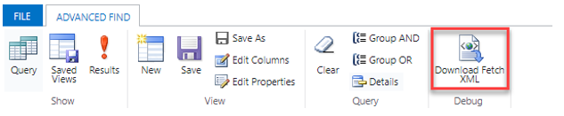
Tools to help build your queries
Download FetchXML function
Notes:
If you're querying data against a model-driven app that is built on Common Data Service, the simplest method for building FetchXML queries is to use Advanced Find, which contains a Download FetchXML function. You are limited to the UI on what filters and related data that you can pull, but it's frequently an excellent first start so that you don't have to compose the XML anew.
Another notable tool, called FetchXML Builder, can be found at XrmToolBox. With this tool, you can construct FetchXML in ways that Advanced Find cannot (aggregates, outer joins, "has no" queries, and attributes from multi-level linked entities). It also provides a wealth of other features, which you can find at their website: FetchXML Builder.
Additional resources
Go to Microsoft Docs to discover in-depth details on the FetchXML Query Language. The Use FetchXML to query data section covers several advanced topics such as how to handle paging, querying hierarchical data, and much more.

Slide 23
Call Power Automate actions from the Web API
Power Automate contains a feature that allows power users to create their own custom sets of business logic called actions.
Notes:
Power Automate contains a feature that allows power users to create their own custom sets of business logic called actions. From a developer perspective, Microsoft Docs defines an action as a "reusable operation, which may have observable side effects." These side effects include creating or updating records, or anything you can accomplish by using a Classic Common Data Service workflow.
An additional feature of actions is their ability to be invoked through the Web API. As a result, you can encapsulate your low-code automations in such a way that you can use them in nearly any scenario by interacting with them through their associated Web API request and response.
While this lesson doesn't cover how to create actions in detail, it's assumed that you already have a basic understanding of how to build them. If you need more information on how to use actions, you can review the Power Automate documentation on them. See the Classic Common Data Service Actions section for detailed information on how to build Common Data Service actions.

Slide 24
Run actions with the Web API
When a new action is created in your Common Data Service solution, the framework also creates a corresponding Web API request message.
OData
POST [Organization URI]/api/data/v9.0/WinOpportunity HTTP/1.1 Accept: application/json Content-Type: application/json; charset=utf-8 OData-MaxVersion: 4.0 OData-Version: 4.0 { "Status": 3, "OpportunityClose": { "subject": "Won Opportunity", "opportunityid@odata.bind": "[Organization URI]/api/data/v9.0/opportunities(b3828ac8-917a-e511-80d2-00155d2a68d2)" } }
Notes:
When a new action is created in your Common Data Service solution, the framework also creates a corresponding Web API request message. You can run these requests by using a POST operation similar to the following example:
POST [Organization URI]/api/data/v9.0/WinOpportunity HTTP/1.1 Accept: application/json Content-Type: application/json; charset=utf-8 OData-MaxVersion: 4.0 OData-Version: 4.0 { "Status": 3, "OpportunityClose": { "subject": "Won Opportunity", "opportunityid@odata.bind": "[Organization URI]/api/data/v9.0/opportunities(b3828ac8-917a-e511-80d2-00155d2a68d2)" } }
The above example is an HTTP request call to the WinOpportunity action for an opportunity with an opportunityid value of b3828ac8-917a-e511-80d2-00155d2a68d2.

Slide 25
Call pre-built Common Data Service actions
Common Data Service comes with a set of existing actions that you can use to perform common operations.
Notes:
Common Data Service comes with a set of existing actions that you can use to perform common operations. Some of these actions might only apply to model-driven or Dynamics 365 apps. For example, the CalculatePrice action calculates the price in an opportunity/quote/order/invoice, so it would only apply to a Dynamics 365 Sales app where that functionality exists.
For more information about which pre-built actions are available for use through the Web API, see the Web API Action Reference.

Slide 26
Unbound vs. bound actions
An action can be built as either unbound (meaning, it doesn't have a Common Data Service entity correlated to it) or bound (meaning, the logic is tied to a specific entity record).
OData
POST [Organization URI]/api/data/v9.0/contacts(94d8c461-a27a-e511-80d2-00155d2a68d2)/Microsoft.Dynamics.CRM.new_AddNoteToContact HTTP/1.1 Accept: application/json Content-Type: application/json; charset=utf-8 OData-MaxVersion: 4.0 OData-Version: 4.0 { "NoteTitle": "New Note Title", "NoteText": "This is the text of the note" }
Notes:
An action can be built as either unbound (meaning, it doesn't have a Common Data Service entity correlated to it) or bound (meaning, the logic is tied to a specific entity record). SQL developers could consider these actions as similar to Stored Procedures (unbound actions) versus Triggers (bound actions). However, unlike SQL Triggers, you can also run bound actions on demand by providing a corresponding entity record ID as its parameter.
Unbound actions are beneficial for generic logic that might need to run outside the context of a specific entity record, such as the WinOpportunity action that was referenced earlier. To run a bound action against a specific record, you must provide the ID of that record in the URI of your request:
The preceding example calls a custom action that was previously built in the solution called new_AddNoteToContact for a contact with the ID of 94d8c461-a27a-e511-80d2-00155d2a68d2 and then passes the parameters NoteTitle and NoteText to the action. The expected behavior for this procedure would be that a new note would be added to the corresponding contact with the title and text provided.
More details
For more details on how to call actions in code, see the Use Web API actions article in Microsoft Docs.

Slide 27
Use the Web API to impersonate another user
Occasionally, you might need to run logic for another user.
Notes:
Occasionally, you might need to run logic for another user. Within the context of Common Data Service, the logic that you're running will apply all appropriate role and object-based security based on the user whom you're impersonating. This method can be especially effective when you are integrating external systems with a Common Data Service solution where the integration account is a system account versus the user who actually invoked the request.

Slide 28
Implement a Web API request with user impersonation
When calling any Web API method, you can provide a CallerObjectId in your message header to indicate that you want the message to be run for that particular user.
Notes:
When calling any Web API method, you can provide a CallerObjectId in your message header to indicate that you want the message to be run for that particular user. The value of this parameter is their Azure Active Directory (Azure AD) object ID. The Azure Graph API provides a method to query Azure AD user data. For more information, see the Azure AD Graph API Reference.

Slide 29
Determine the user who performed an operation
HTTP/1.1 200 OK
Content-Type: application/json; odata.metadata=minimal
ETag: W/"506868"
{
"@odata.context": "[Organization URI]/api/data/v9.0/$metadata#accounts(name,createdby(fullname,azureactivedirectoryobjectid),createdonbehalfby(fullname,azureactivedirectoryobjectid),owninguser(fullname,azureactivedirectoryobjectid))/$entity",
"@odata.etag": "W/\"2751197\"",
"name": "Sample Account created using impersonation",
"accountid": "00000000-0000-0000-000000000003",
"createdby": {
"@odata.etag": "W/\"2632435\"",
"fullname": "Impersonated User",
"azureactivedirectoryobjectid": "e39c5d16-675b-48d1-8e67-667427e9c084",
"systemuserid": "75df116d-d9da-e711-a94b-000d3a34ed47",
"ownerid": "75df116d-d9da-e711-a94b-000d3a34ed47"
},
"createdonbehalfby": {
"@odata.etag": "W/\"2632445\"",
"fullname": "Actual User",
"azureactivedirectoryobjectid": "3d8bed3e-79a3-47c8-80cf-269869b2e9f0",
"systemuserid": "278742b0-1e61-4fb5-84ef-c7de308c19e2",
"ownerid": "278742b0-1e61-4fb5-84ef-c7de308c19e2"
},
"owninguser": {
"@odata.etag": "W/\"2632435\"",
"fullname": "Impersonated User",
"azureactivedirectoryobjectid": "e39c5d16-675b-48d1-8e67-667427e9c084",
"systemuserid": "75df116d-d9da-e711-a94b-000d3a34ed47",
"ownerid": "75df116d-d9da-e711-a94b-000d3a34ed47"
}
}
OData
GET [Organization URI]/api/data/v9.0/accounts(00000000-0000-0000-000000000003)?$select=name&$expand=createdby($select=fullname),createdonbehalfby($select=fullname),owninguser($select=fullname) HTTP/1.1 Accept: application/json OData-MaxVersion: 4.0 OData-Version: 4.0
Notes:
If you need to see the ID of the user who actually performed an operation for another user, you can query the record's createdonbehalfby value, which will contain this detail. For example, if you want to see if an account record was created through user impersonation rather than by the actual user, you could query that account record to compare their createdby and createdonbehalfby values by using the following query:
If the record was created by an impersonating account, you can expect a response similar to the following example:

Slide 30
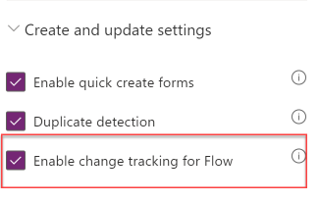
Enable change tracking for an entity
You can enable change tracking on an entity by setting the Enable change tracking for Flow flag on the entity settings in the PowerApps maker portal, found under the More settings > Create and update settings section.
Notes:
Track entity data changes with change tracking and the Web API
Commonly, organizations need to synchronize data across multiple systems. Microsoft Dataverse provides a feature to efficiently manage this scenario, called change tracking. With change tracking enabled, you can build applications to query for these changes.
You can enable change tracking on an entity by setting the Enable change tracking for Flow flag on the entity settings in the PowerApps maker portal, found under the More settings > Create and update settings section. As its name indicates, this feature can be used frequently by Power Automate to allow you to trigger automations based on changes that are made to a given entity record.

Slide 31
Delta links
According to the OData 4.0 documentation, delta links are "opaque, service-generated links that the client uses to retrieve subsequent changes to a result." Microsoft has built this standard into change tracking in Common Data Service to provide a common, standard method for interfacing with change data as it occurs over time.
Notes:
According to the OData 4.0 documentation, delta links are "opaque, service-generated links that the client uses to retrieve subsequent changes to a result." Microsoft has built this standard into change tracking in Common Data Service to provide a common, standard method for interfacing with change data as it occurs over time. For more information on delta links, see OData Version 4.0 - Delta Links. After issuing a change tracking request, your response will contain a delta link, which you'll then pass to your next request to get changes that have occurred since the initial request. It will be up to your app to maintain the delta link, similarly to how you might have done tracking with date/time stamps in the past.

Slide 32
Retrieve changes in entities by using the Web API
OData
OData
{
"@odata.context":"[Organization URI]/data/v9.0/$metadata#accounts(name,telephone1,fax)/$delta",
"@odata.deltaLink":"[Organization URI]/api/data/v9.1/accounts?$select=name,telephone1,fax&$deltatoken=919058%2108%2f22%2f2017%2008%3a21%3a20",
"value":
[
{
"@odata.etag":"W/\"915244\"",
"name":"Monte Orton",
"telephone1":"555000",
"fax":"10101",
"accountid":"60c4e274-0d87-e711-80e5-00155db19e6d"
},
{
"@odata.context":"[Organization URI]/api/data/v9.0/$metadata#accounts/$deletedEntity",
"id":"2e451703-c686-e711-80e5-00155db19e6d",
"reason":"deleted"
}
]
}
GET [Organization URI]/org1/api/data/v9.1/accounts?$select=name,accountnumber,telephone1,fax HTTP/1.1
Prefer: odata.track-changes
Cache-Control: no-cache
OData-Version: 4.0
Content-Type: application/json
Notes:
After you've enabled change tracking on an entity, you can retrieve its changes through the Web API by adding odata.track-changes as a preference header in your web request. The following example requests changes from the account entity for a specific set of fields (name, account number, telephone1, and fax).
On the initial request, you'll receive the entire set of data that applies to the query because a delta has not been applied. However, the response will show an @odata.deltaLink value. This link contains a deltatoken parameter, which is intended to be passed into your subsequent request when you want to see what changes have been applied since this query was run. Think of this process as similar to how you would handle paging in OData.
The following example is a response to the preceding account request:
In this scenario, consider that some time has passed, and you now want to see if any other changes have been applied. You can use the @odata.deltaLink parameter to run your query (or extract its deltatoken if you are managing connection strings differently), and see what changes have happened since your last request.

Slide 33
Retrieve changes in entities by using the Web API
OData
GET [Organization URI]/api/data/v9.1/accounts?$select=name,accountnumber,telephone1,fax&$deltatoken=919042%2108%2f22%2f2017%2008%3a10%3a44
{
"@odata.context":"[Organization URI]/data/v9.1/$metadata#accounts(name,telephone1,fax)/$delta",
"@odata.deltaLink":"[Organization URI]/api/data/v9.1/accounts?$select=name,telephone1,fax&$deltatoken=919058%2108%2f22%2f2017%2008%3a21%3a20",
"value":
[
{
"@odata.etag":"W/\"915244\"",
"name":"Monte Orton",
"telephone1":"555000",
"fax":"10101",
"accountid":"60c4e274-0d87-e711-80e5-00155db19e6d"
},
{
"@odata.context":"[Organization URI]/api/data/v9.1/$metadata#accounts/$deletedEntity",
"id":"2e451703-c686-e711-80e5-00155db19e6d",
"reason":"deleted"
}
]
}
Notes:
The following example shows how you would retrieve changes since that last request by running the returned @odata.deltaLink:
In this scenario, imagine that a new account was created and another one was deleted. Your response would then look similar to the following example:
As shown in the example, another delta link was provided, which you can then use the next time you need to see what changes have occurred.

Slide 34
Retrieve the number of changes in a delta
You can also retrieve the number of changes made in a given delta by adding the $count parameter to your request.
Text
GET [Organization URI]/api/data/v9.1/accounts/$count?$deltatoken=919042%2108%2f22%2f2017%2008%3a10%3a44
Notes:
You can also retrieve the number of changes made in a given delta by adding the $count parameter to your request.
GET [Organization URI]/api/data/v9.1/accounts/$count?$deltatoken=919042%2108%2f22%2f2017%2008%3a10%3a44

Slide 35
Integrate Common Data Service Azure solutions

Slide 36
Common Data Service Azure Solutions overview
Because Common Data Service is built as part of the robust Microsoft Power Platform, it provides numerous capabilities to facilitate integration with Microsoft Azure solutions.
Notes:
Because Common Data Service is built as part of the robust Microsoft Power Platform, it provides numerous capabilities to facilitate integration with Microsoft Azure solutions. This lesson covers some of the standard integration practices regarding Azure solutions and how they pertain to Common Data Service.

Slide 37
Comparing Azure's integration solutions
Logic Apps - Azure Logic Apps provides a robust visual interface in which you can orchestrate complex integrations across your various environments.
Azure Service Bus - Azure Service Bus is Microsoft's cloud messaging as a service (MaaS) platform.
Azure API Management - Because API needs are handled by Dataverse Web API, and because Dataverse provides a role-based security model that can handle most integration scenarios, you might not need to consider Microsoft Azure API Management often.
Event Grid - Microsoft Azure Event Grid is an event-driven, publish-subscribe framework that allows you to handle various events.
Event Hubs - Azure Event Hubs is Microsoft's version of Apache Kafka and provides a real-time data ingestion service that supports millions of events per second.
Notes:
Azure comes with a variety of other solutions, which can also be integrated with Common Data Service. The following sections provide a summary of each solution. However, this module will limit further education in future lessons to the solutions that have pre-configured utilities within Common Data Service that help streamline your integrations, such as Microsoft Azure Service Bus, Microsoft Azure Event Hubs, and Microsoft Azure Logic Apps. Logic Apps
Azure Logic Apps provides a robust visual interface in which you can orchestrate complex integrations across your various environments. It has many of the same capabilities as Microsoft Power Automate workflows, so if you are familiar with preparing workflows in that context, you should be able to recognize their similarities. Both provide the ability to use pre-built and custom-built connectors, which you can use to connect to whichever system is needed. Most importantly, Logic Apps comes with a Microsoft Dataverse connector that will allow you to trigger actions based on various Dataverse events (such as a record being created or updated).
Azure Service Bus
Azure Service Bus is Microsoft's cloud messaging as a service (MaaS) platform. Messages are sent to and received from queues for point-to-point communications. Service Bus also provides a publish-subscribe mechanism that uses its Topics feature, which will not be covered in this module.
Azure API Management
Because API needs are handled by Dataverse Web API, and because Dataverse provides a role-based security model that can handle most integration scenarios, you might not need to consider Microsoft Azure API Management often. However, if you ever need to write a custom and/or proprietary API to sit on top of the Dataverse Web API, you could use Azure's API Management services.
Event Grid
Microsoft Azure Event Grid is an event-driven, publish-subscribe framework that allows you to handle various events. While Dataverse does not provide out-of-the-box capabilities to integrate with an Event Grid instance as it does with Service Bus or Event Hubs, it is a viable item to consider when you are in need of event-driven integrations.
Event Hubs
Azure Event Hubs is Microsoft's version of Apache Kafka and provides a real-time data ingestion service that supports millions of events per second. This service is good for large streams of data that need to be ingested in real time (which might occur when you are trying to capture items like application telemetry within a business application) but are not common in most business application integration scenarios. Technically, Event Hubs is not seen as an integration solution in Azure (it's seen as an analytics solution given that its predominant applications are with "big data"). Dataverse provides a utility to publish events to an Event Hub. In the context of Common Data Service, while provided as an endpoint, Azure Service Bus traditionally becomes the preferred method for integration of actual business data because it comes with far less overhead.

Slide 38
Choosing the right Azure integration solution
If you're struggling to figure out which Azure integration solution best suits your needs, consider the information in the following table.
IF YOU WANT TO... | USE THIS
Create workflows and orchestrate business processes to connect hundreds of services in the cloud and on-premises. | Logic Apps
Connect on-premises and cloud-based applications and services to implement messaging workflows | Service Bus
Publish your APIs for internal and external developers to use when connecting to backend systems that are hosted anywhere. | API Management
Connect supported Azure and third-party services by using a fully managed event-routing service with a publish-subscribe model that simplifies event-based app development. | Event Grid
Continuously ingest data in real time from up to hundreds of thousands of sources and stream a million events per second. | Event Hubs
Notes:
If you're struggling to figure out which Azure integration solution best suits your needs, consider the information in the following table.
For in-depth guidance on Azure's broader Integration Services framework, refer to the Azure Integration Services whitepaper, which is found here.
Another article to reference is one found on the Azure website: Choose between Azure messaging services - Event Grid, Event Hubs, and Service Bus.

Slide 39
Exercise: Expose Common Data Service data to Azure Service Bus
Follow the scenario exercise in the student manual
Notes:
Common Data Service provides a variety of pre-built mechanisms for externalizing its data for integration purposes. This lesson covers how to accomplish exposing Common Data Service data to Azure Service Bus by using Common Data Service's Service Endpoint Registration feature, which is found in its Plug-in Registration Tool.
Exercise or potential demo
https://docs.microsoft.com/en-us/learn/modules/integrate-common-data-service-azure-solutions/2-azure-service-bus

Slide 40
Types of supported Service Bus contracts
Queue - Queue listeners are not required for this type of queue. You can consume queued messages in a "destructive" or "non-destructive" read. A destructive read will read the message from the queue and remove it, whereas a non-destructive read will not remove the message from the queue. This method is useful for "send-and-forget" scenarios where it is not critical that the message is received at a given point of time.
Topic - Topic listeners are similar to queue listeners, except that one or more listeners can subscribe to receive messages for a given topic. This type is useful if you require multiple consumers for a given message.
One-way - One-way contracts require that an active event listener be available to consume a message that is posted to the Service Bus queue. If no active listener is available, the post will fail. If the post fails, Dataverse will retry posting the message in exponentially larger and larger time spans until the asynchronous system job is eventually canceled. In this case, the System Job status of this event will be set to Failed.
Two-way - Two-way contracts are similar to one-way contracts, except that they also provide the ability to return a string value from the listener. If you've registered a custom Azure-aware plug-in to post your message, you can then consume this returned data within your plug-in. A common application of this scenario might be if you want to retrieve the ID of a record that was created in an external system as part of your listener's process to maintain it in your Dataverse environment.
REST - REST contracts are similar to two-way contracts except that it is exposed on a REST endpoint.

Slide 41
Exercise: Write a queue listener
Follow the scenario exercise in the student manual
Notes:
In the previous exercise, you registered a Service Endpoint that publishes messages to a Service Bus Endpoint whenever account data is updated in your Dataverse environment. This exercise now describes how to consume those messages.
Exercise or potential demo
https://docs.microsoft.com/en-us/learn/modules/integrate-common-data-service-azure-solutions/3-event-listener

Slide 42
Publish Common Data Service events with webhooks
Another method for publishing events from Common Data Service to an external service is to register webhooks.
Notes:
Another method for publishing events from Common Data Service to an external service is to register webhooks. A webhook is an HTTP-based mechanism for publishing events to any Web API-based service of your choosing. This method allows you to write your own custom code that is hosted on external services as a point-to-point.

Slide 43
Webhooks vs. Azure Service Bus
When considering integration mechanisms, you have a few available options.
High scale asynchronous processing/queueing is a requirement.
Multiple subscribers might be needed to consume a given Common Data Service event.
You want to govern your integration architecture in a centralized location.
Notes:
When considering integration mechanisms, you have a few available options. It's important that you consider various elements when choosing a given method.
Consider using Azure Service Bus when:
High scale asynchronous processing/queueing is a requirement.
Multiple subscribers might be needed to consume a given Common Data Service event.
You want to govern your integration architecture in a centralized location.
Consider using webhooks when:
Synchronous processing against an external system is required as part of your process (Common Data Service only supports asynchronous processing against Service Bus Endpoints).
The external operation that you are performing needs to occur immediately.
You want the entire transaction to fail unless the webhook payload is successfully processed by the external service.
A third-party Web API endpoint already exists that you want to use for integration purposes.
SAS authentication isn't preferred and/or feasible (webhooks support authentication through authentication headers and query string parameter keys).

Slide 44
Webhook authentication options
The following table describes the three authentication options that you can use to consume a webhook message from a given endpoint.
Type | Description
HttpHeader | Includes one or more key value pairs in the header of the HTTP request. Example: Key1: Value1, Key2: Value2
WebhookKey | Includes a query string by using code as the key and a value that is required by the endpoint. When registering the webhook by using the Plug-in Registration Tool, only enter the value. Example: ?code=00000000-0000-0000-0000-000000000001
HttpQueryString | Includes one or more key value pairs as query string parameters. Example: ?Key1=Value1&Key2=Value2
Notes:
The following table describes the three authentication options that you can use to consume a webhook message from a given endpoint.
Type Description
HttpHeader
Includes one or more key value pairs in the header of the HTTP request. Example: Key1: Value1, Key2: Value2
WebhookKey
Includes a query string by using code as the key and a value that is required by the endpoint. When registering the webhook by using the Plug-in Registration Tool, only enter the value. Example: ?code=00000000-0000-0000-0000-000000000001
HttpQueryString
Includes one or more key value pairs as query string parameters. Example: ?Key1=Value1&Key2=Value2

Slide 45
Webhook HTTP headers
The following table shows the HTTP headers that are passed to your service as part of a webhook call.
Key | Value Description
x-request-id | A unique identifier for the request
x-ms-dynamics-organization | The name of the tenant who sent the request
x-ms-dynamics-entity-name | The logical name of the entity that passed in the execution context data
x-ms-dynamics-request-name | The name of the event that the webhook step was registered for
x-ms-correlation-request-id | Unique identifier for tracking any type of extension. This property is used by the platform for infinite loop prevention. In most cases, this property can be ignored. This value can be used when you are working with technical support because it can be used to query telemetry to understand what occurred during the entire operation.
x-ms-dynamics-msg-size-exceeded | Sent only when the HTTP payload size exceeds the 256KB
Notes:
The following table shows the HTTP headers that are passed to your service as part of a webhook call. You can use these headers as part of your processing method if you are writing a new webhook processor.
Key Value Description
x-request-id
A unique identifier for the request
x-ms-dynamics-organization
The name of the tenant who sent the request
x-ms-dynamics-entity-name
The logical name of the entity that passed in the execution context data
x-ms-dynamics-request-name
The name of the event that the webhook step was registered for
x-ms-correlation-request-id
Unique identifier for tracking any type of extension. This property is used by the platform for infinite loop prevention. In most cases, this property can be ignored. This value can be used when you are working with technical support because it can be used to query telemetry to understand what occurred during the entire operation.
x-ms-dynamics-msg-size-exceeded
Sent only when the HTTP payload size exceeds the 256KB

Slide 46
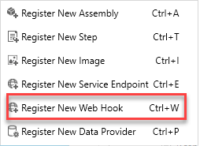
Register a Webhook endpoint
Webhook endpoint registration is performed similarly to Service Endpoint registration, by using the Plug-in Registration Tool.
Notes:
Webhook endpoint registration is performed similarly to Service Endpoint registration, by using the Plug-in Registration Tool.
Within the Plug-in Registration Tool, you can register a new webhook by selecting Register New Web Hook under the Register menu option.
The following WebHook Registration dialog box will appear, where you can configure the URL of your endpoint, along with any authentication options.

Slide 47
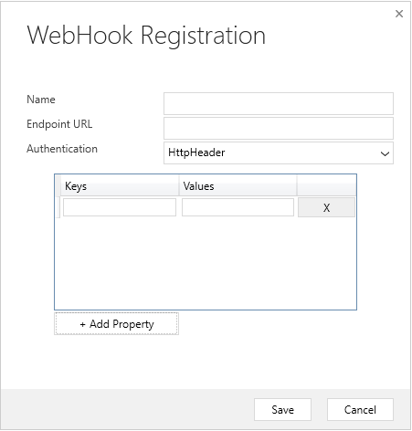
Register with HTTPHeader Authentication
If HttpHeader authentication is selected, the screen will prompt you to add Keys and Values that will be passed as part of your HTTP request.
Notes:
If HttpHeader authentication is selected, the screen will prompt you to add Keys and Values that will be passed as part of your HTTP request. Commonly, the keys and values might include an OAuth bearer token or other various authentication formats.

Slide 48
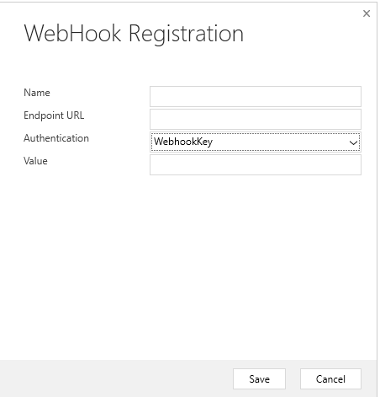
Register with WebhookKey Authentication
If WebhookKey is specified as the Authentication method, a query string is passed to the URL with the given key in the format ?code=[web hook key].
Notes:
If WebhookKey is specified as the Authentication method, a query string is passed to the URL with the given key in the format ?code=[web hook key]. This method is handy when you are calling Azure Functions because it uses this code parameter by default to perform its authentication.

Slide 49
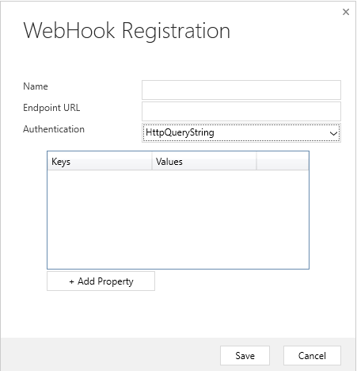
Register with HTTPQueryString Authentication
You can pass Query String parameters by specifying HttpQueryString as the Authentication option.
Notes:
You can pass Query String parameters by specifying HttpQueryString as the Authentication option. As with the HTTPHeader option, it presents the option to pass a set of key/value pairs to your Web API. You could also pass additional parameters, and even manually pass the "code" parameter that is expected through Azure Functions in this manner.

Slide 50
Register with HTTPQueryString Authentication
You can pass Query String parameters by specifying HttpQueryString as the Authentication option.
Notes:
You can pass Query String parameters by specifying HttpQueryString as the Authentication option. As with the HTTPHeader option, it presents the option to pass a set of key/value pairs to your Web API. You could also pass additional parameters, and even manually pass the "code" parameter that is expected through Azure Functions in this manner.

Slide 51
Azure Functions vs. plug-ins
Microsoft Azure Functions provides a great mechanism for doing small units of work, similar to what you would use plug-ins for in Common Data Service.
Notes:
Microsoft Azure Functions provides a great mechanism for doing small units of work, similar to what you would use plug-ins for in Common Data Service. In many scenarios it might make sense to offload this logic into a separate component, such as an Azure Function, to reduce load on the Common Data Service's application host. You have the availability to run functions in a synchronous capacity because Common Data Service webhooks provide the Remote Execution Context of the given request.
However, Azure Functions does not explicitly run within the Common Data Service's implementation pipeline, so if you need to update data in the most high-performing manner, such as autoformatting a string value before it posts to Common Data Service, we still recommend that you use a plug-in to perform this type of operation.

Slide 52
Exercise: Write an Azure Function that processes Common Data Service events
Follow the scenario exercise in the student manual
Notes:
In the previous exercise, you registered a Service Endpoint that publishes messages to a Service Bus Endpoint whenever account data is updated in your Common Data Service environment. This exercise now describes how to consume those messages.
Exercise or potential demo
https://docs.microsoft.com/en-us/learn/modules/integrate-common-data-service-azure-solutions/5-azure-function

Slide 53
Publish an event by using the API in Plug-in
Register ServiceEndpoint
Azure Service Bus
Azure Event Hub
Guid serviceEndpointId = <ID of registered Service Endpoint>
IPluginExecutionContext context = (IPluginExecutionContext)serviceProvider.GetService(typeof(IPluginExecutionContext));
IServiceEndpointNotificationService cloudService =
(IServiceEndpointNotificationService)serviceProvider.GetService(typeof(IServiceEndpointNotificationService));
if (cloudService == null)
throw new InvalidPluginExecutionException("Failed to retrieve the service bus service.");
string response = cloudService.Execute(new EntityReference("serviceendpoint", serviceEndpointId), context);
if (!String.IsNullOrEmpty(response))
{
tracingService.Trace("Response = {0}", response);
}
Notes:
· publish an event by using the API
Determine whether to use Azure Service Bus (topics, queues, or relay) or Azure Event Hub
Very important for exam coverage to demo - Write the plug-in code https://docs.microsoft.com/powerapps/developer/common-data-service/write-custom-azure-aware-plugin

Slide 54
Change Tracking
Changes since last request
Enable on Entity
RetrieveEntityChangesRequest
Token – keep and use to call to next time
Multiple Tokens allowed – last 90 days
Set Token to null for initial extract
Notes:
· configure entity change tracking
Enable change tracking to control data synchronization
https://docs.microsoft.com/power-platform/admin/enable-change-tracking-control-data-synchronization

Slide 55
Demo – Change Tracking
Notes:
· read entity change records by using platform APIs
Use change tracking to synchronize data with external systems
Process create, update, and deletes
DEMO
Sample: Synchronize data with external systems using change tracking https://docs.microsoft.com/powerapps/developer/common-data-service/org-service/samples/synchronize-data-external-systems-using-change-tracking

Slide 56
Alternate keys
For Integration
Create for existing field(s)
Indexed
Performance
using (var service = new OrganizationService(crmConnection))
{
// Use alternate key (accountnumber) field to identify an account record
Entity account = new Entity("account", "accountnumber", “MIC-12345");
// Set new credit limit;
account["creditlimit"] = new Money(100000);
UpdateRequest request = new UpdateRequest() { Target = account };
UpdateResponse response = (UpdateResponse)service.Execute(request);
}
Notes:
· create and use alternate key
Create alternate keys Upsert and what is needed

Slide 57
Upsert
Insert or Update in one request
Use when don’t know if record exists
Need to provide “enough” information
using (var service = new OrganizationService(crmConnection))
{
// Use alternate key (accountnumber) field to identify an account record
var account = new Entity("account")
{
KeyAttributes = new KeyAttributeCollection
{
{"accountnumber", “MIC-12345" }
}
};
account["name"] = "Microsoft";
account["creditlimit"] = new Money(100000);
var request = new UpsertRequest() { Target = account };
var response = (UpsertResponse)service.Execute(request);
}
Notes:
· create and use alternate key
Create alternate keys Upsert and what is needed

